Slide 1
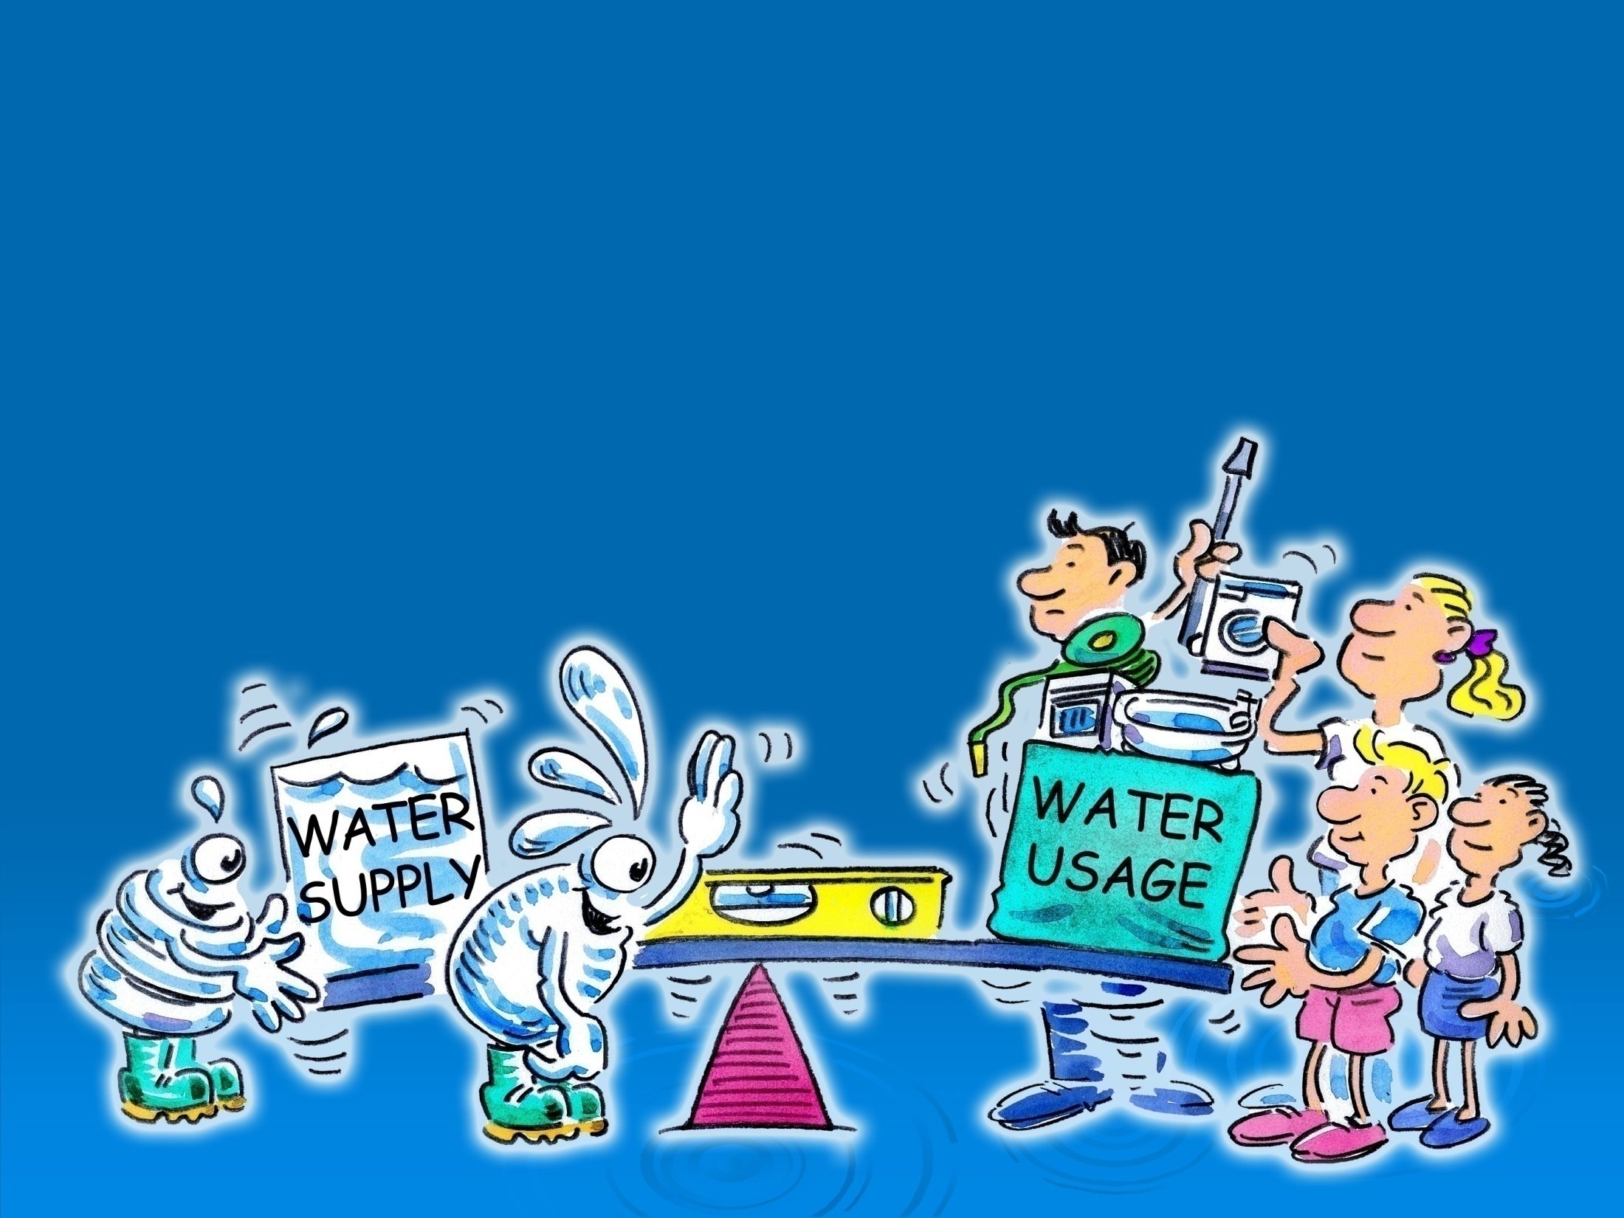
Saving Water Workshop

Slide 3
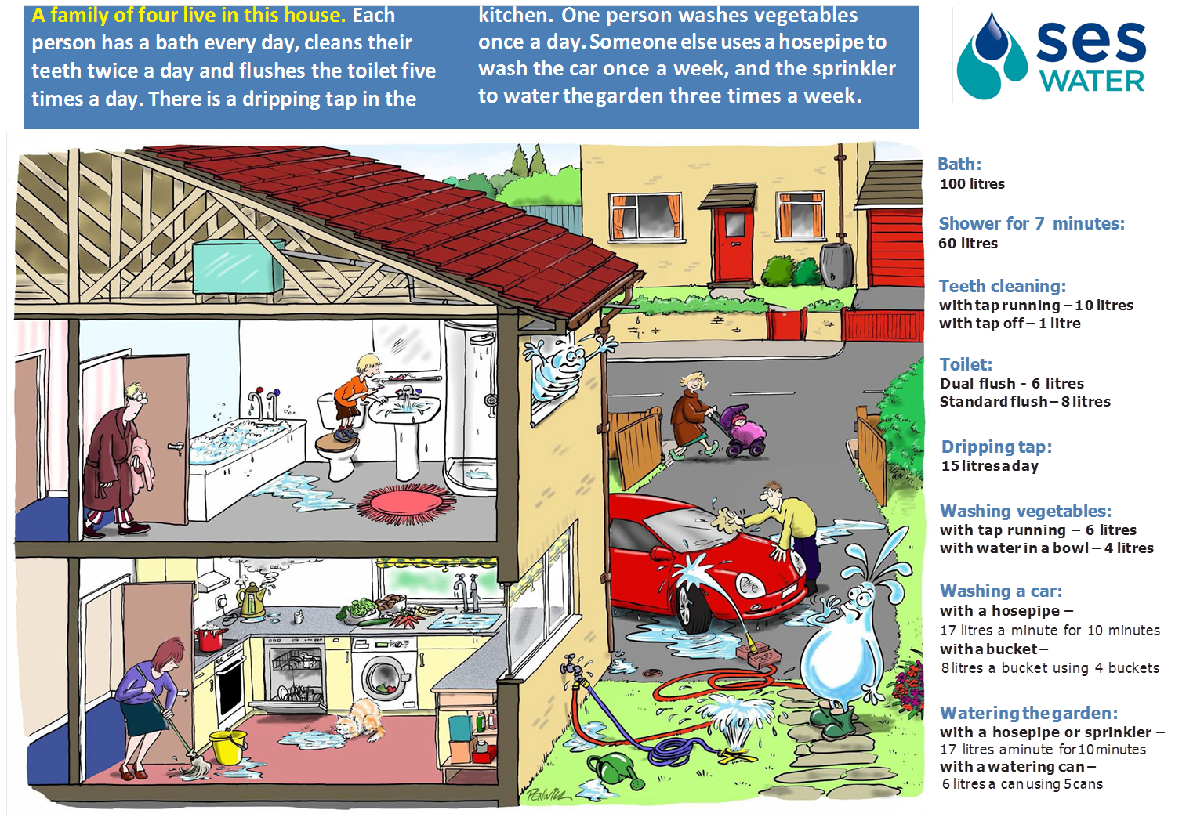

Slide 5
Water x People x Number of times a day

Slide 6
Activity | Calculations | Amount of water used each day
Bath
Shower
Teeth –leaving the tap running
Teeth –turning the tap off
Toilet – standard flush
Toilet – dual flush
Dripping tap
Dripping tap - repaired
Washing vegetables –tap running
Washing vegetables –in a bowl
Washing the car - hosepipe
Washing the car - bucket
Watering the garden - sprinkler
Watering the garden – watering can
100 x 4 x 7
2800 litres
60 x 4 x 7
1680 litres
10 x 2 x 4 x 7
560 litres
1 x 2 x 4 x 7
56 litres
8 x 5 x 4 x 7
1120 litres
6 x 5 x 4 x 7
840 litres
15 x 7
105 litres
0
6 x 7
42 litres
4 x 7
28 litres
17 x 10
170 litres
8 x 4
32 litres
17 x 10 x 3
510 litres
6 x 5 x 3
90 litres

Slide 7
Activity | Wasters use | Savers use | Difference
Bath/shower | 2800 litres | 1680 litres
Cleaning teeth | 560 litres | 56 litres
Flushing the toilet | 1120 litres | 840 litres
Dripping tap | 105 litres | 0 litres
Preparing vegetables | 42 litres | 28 litres
Washing the car
Watering the garden | 510 litres | 90 litres
Total
1120 litres
504 litres
280 litres
105 litres
14 litres
170 litres
32 litres
138 litres
420 litres
5,307 litres
2,726 litres
Altogether the amount of water that could be saved is
2,581 litres

Slide 8
